Slide 1
Before using this slide deck, please read AERO's practice resource, A Whole School Approach to Classroom Management: Facilitation Guide, and follow the instructions for preparing this slide deck.

Slide 2
Evidence-based approaches for effective classroom management
Notes:
Preparation
You may want to spread the Evidence-Based Approaches for Effective Classroom Management professional learning over 3 sessions:
Session 1: Introduction and positive relationships (up to slide 15, approximately 30 minutes)
Session 2: High expectations, routines and rules (slides 16–28, approximately 40 minutes)
Session 3: Classroom management skills, planning for classroom management and responding to disengaged and disruptive behaviour, with final activity (slides 29–48, approximately 35 minutes).
On this (and every) slide, consider the staff in your context and whether the language and tone of the facilitator notes need to be adjusted for them.
Consider asking experienced teachers in your school to share their expertise or specific experiences during the session or co-facilitate parts of this session with you.
Consider your rationale for developing a shared understanding of effective classroom management approaches and practice. How might you explain this rationale to staff? For example, you might identify from school survey and/or behaviour data the need to explore the evidence-based practices in classroom management to support student safety and learning.
Remember to delete the preparation section in each slide note once you’ve followed its instructions.
Facilitator notes
If you are using Presenter View, increase the space for slide notes by dragging the vertical and horizontal lines beside it. You can also adjust the font size using the 2 buttons below the slide notes.
In this session, we will review evidence-based approaches to classroom management. Our goal is to strengthen our collective understanding of effective classroom management.

Slide 3
Acknowledgement of Country
Notes:
Preparation
Edit this slide to reflect the way your school Acknowledges Country.

Slide 4
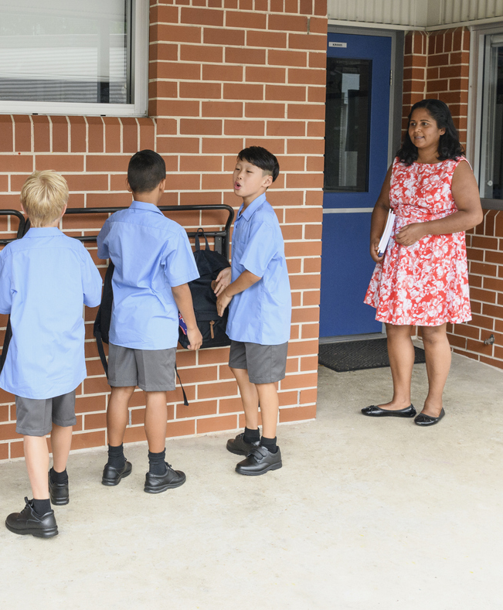
Purpose of this session
To develop a shared understanding of effective classroom management approaches and practice.
Image credit: iStock.com/JohnnyGreig
Notes:
Preparation
Optionally, replace this photo (and any other photos in this presentation) with photos of your school community.

Slide 5

Notes:
Preparation
Prior to the session, provide participants with a link to AERO’s Foundational Classroom Management Resources Handbook. Some participants may want to look over the handbook prior to the session. You can find the handbook at https://www.edresearch.edu.au/classroom-management-handbook
Please hide this slide if you’re confident that participants have downloaded the handbook.
Facilitator notes
Remind participants that they have been sent the link to AERO’s Foundational Classroom Management Resources Handbook, which provides more detail on the evidence-based approaches you will be going through and provides practical guidance to support teachers with refining their classroom management practices and skills.

Slide 6

The Australian Education Research Organisation (AERO) is Australia’s independent education evidence body, established and funded by Commonwealth, state and territory governments.
Notes:
Preparation
Consider your context and the staff members you are addressing. How can you frame the benefits of evidence-based practices to best speak to their roles and needs?
Facilitator notes
This session will provide an overview of the evidence base for effective classroom management practices. The Australian Education Research Organisation (AERO) has synthesised the evidence and developed practical resources to support schools with implementing evidence-based practices. These practices enable us to teach more efficiently and effectively to best support student learning.
AERO was established in 2021 to support the use of evidence in schools and early childhood settings.
The information in this session is based on the most rigorous and relevant research evidence and guidance available from a wide range of researchers and experts across Australia and internationally.

Slide 7
A model of learning and teaching
Notes:
Preparation
Prior to the session, read AERO’s Teaching for How Students Learn: A Model of Learning and Teaching. You can find the model at https://www.edresearch.edu.au/guides-resources/practice-resources/teaching-how-students-learn-model-learning-and-teaching
Be ready to provide a copy of this model to participants after the session.
Facilitator notes
As we discuss classroom management today, you may find yourself thinking about how it aligns with high-quality teaching.
Classroom management is a critical enabling factor for high-quality teaching. AERO has developed an evidence-based model of learning and teaching that identifies how students learn, along with the teaching practices that best align with this process and that are most effective in supporting student learning. Classroom management sits in the Enabling phase of the model, which focuses on fostering the conditions of a learning-focused environment.
Evidence-based, inclusive and culturally responsive whole-class teaching practices promote positive behaviour and are fundamental to addressing low-level disengagement and disruption. These high-quality teaching practices are a key proactive and preventative approach to managing student behaviour.
This means that classroom management and high-quality teaching are interconnected and work hand-in-hand.
I’ll provide a link to the model of learning and teaching after the session. Resources to support the practices are linked within the model.

Slide 8
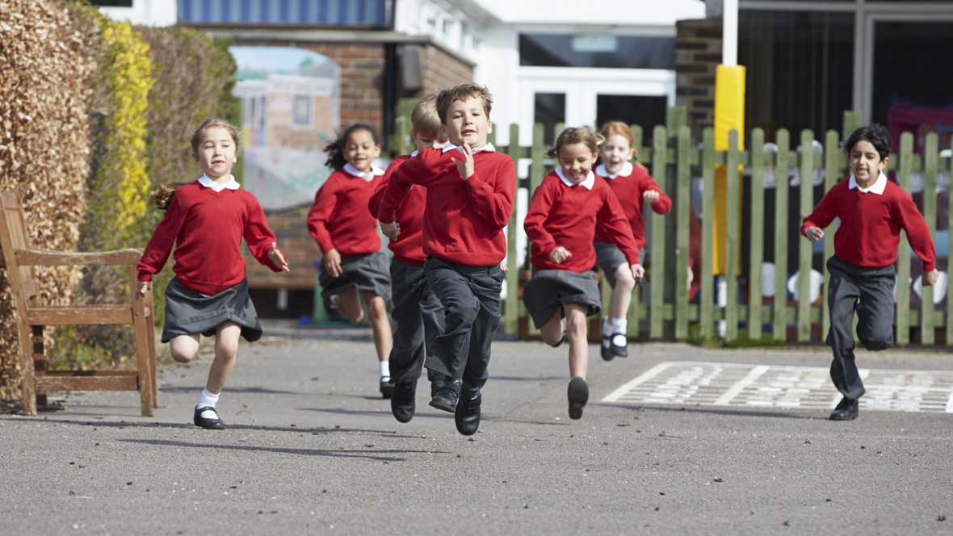
Image credit: iStock.com/MonkeybusinessImages
Notes:
Preparation
You may want to replace this photo (and any other photos in the slide deck) with a photo of your own students
The facilitator notes refer to a paper by Blazer and Pollard (2022). You can read the full paper at https://doi.org/10.26300/ajht-4d94.
Facilitator notes
Consider for a moment the work you do to manage your classrooms. It’s easy to take for granted, and important to acknowledge, the expertise and skill set that we bring to our work.
Bringing 20-30 people together to do something is complex.
Add to that, the people we’re bringing together are still developing children and young people and we need to focus them on learning. Managing this is part of the highly skilled work that teachers do.
Blazer and Pollard (2022) write about the ongoing, and often simultaneous, balancing act that teachers undertake every day – delivering content, supporting social-emotional development, and addressing individual and group needs.
And we do this with consideration and planning, and through a combination of evidence-based practices and skills, and strong relationships.

Slide 9
Classroom management
“
The actions teachers take to create an environment that supports and facilitates both academic and social-emotional learning.
Evertson & Weinstein (2006)
”
Notes:
Preparation
Consider how staff at your school will respond to this definition. Might they need a short discussion around it?
Facilitator notes
Give staff time to read the definition provided.
This session is a good opportunity to reflect on the actions you take to create a safe and inclusive environment that supports learning. Classroom management is all about teacher actions in teacher-led classrooms. These actions are intentional and planned. Importantly, they include the actions we take to build relationships with our students and create an environment that is safe and orderly, and supports student academic and social-emotional learning.
Optionally, allow participants time to discuss how the definition sits with their understanding of classroom management.
In our discussions today, please remember that we come to this with varying levels of experience, so we’ll all support each other as we collaboratively strengthen our shared understanding of evidence-based classroom management.

Slide 10

Reflection
What is one strength I have in managing classrooms? How do I know?
What is one challenge in managing classrooms that I would personally like
to address? Why is this important to
my practice?
Notes:
Preparation
The questions on this slide invite participants to consider their individual strengths and challenges, rather than the strengths and challenges of the school. This reflects the definition of classroom management on the previous slide, which refers to ‘the actions teachers take’. Individual reflection and refinement is a necessary component of a whole-school approach to classroom management.
Facilitator notes
We’re working together to refine our shared understanding of classroom management. Every one of us brings strengths to this collaboration. It’s also important to be clear about the challenges we would like to address.
Provide time for reflection and/or discussion. Allow 3 or 5 minutes, depending on whether it’s individual or group reflection.
Keep the strengths in mind – they’re important to keep doing, and they’re especially important on difficult days so that you can remind yourself of the many things you’re doing well and keep doing them.
Keep the challenges in mind. AERO has created resources that can help refine the practices and skills needed to support the challenges. This session might spark ideas for refinement.

Slide 11
Proactive and preventative approaches
Positive relationships
High expectations, routines and rules
Notes:
Preparation
Consider how these evidence-based approaches complement existing knowledge and approaches in your school to relate this to what staff already know – for example, PBiS (Positive Behavioural Interventions and Support)/PBL (Positive Behaviour for Learning)/SWPBS (Schoolwide Positive Behaviour Support).
Compile a list of specific examples of good practice in your school that you can share.
The evidence-based practices are for all ages of students. Your staff will, of course, adjust their language and communication as appropriate for their students.
Facilitator notes
These evidence-based approaches will likely not be new to you. For example, they support [name the existing advice and resources in your school].
The evidence-based approaches are establishing and maintaining positive teacher–student relationships and high expectations, routines and rules to create safe and supportive learning environments.
Share specific examples of good practice in your school.
Today’s session will be a confirmation of our practices that are aligned with the evidence base. It will also provide opportunities to consider further refinement.
Consider what you already know about and do in relation to these approaches.
- You’ve already identified a strength and challenge to keep in mind. As we unpack the evidence today, other strengths and challenges will come to mind.
- You may identify practices that have reduced in focus within your classroom – so you can use this session as a reminder to refocus and refine your practice.
- There might also be new things to consider in effectively managing your classroom.

Slide 12
Positive teacher–student relationships
Why?
To create a positive learning environment where students feel:
  safe
  respected
  motivated to learn.
Notes:
Preparation
Prior to facilitating this section, you may want to read Chapters 1 and 5 of AERO’s Foundational Classroom Management Resources Handbook. You may want to refer participants to these chapters if you’re unsure how to answer a question.
Facilitator notes
First, we’ll look at positive relationships. Positive teacher-student relationships create a learning environment where students feel safe, respected and motivated to learn.
Cultural safety is experienced when an environment is created that is psychologically, spiritually, socially, physically and emotionally safe for students, their families and their communities. To create culturally safe environments, teachers need to be culturally responsive, examining their own identities, cultures, histories, biases, values and knowledge and considering how these influence their thinking and impact their decision-making and reactions. They then need to think about how these decision and reactions impact their students and families. Getting to know and understand their students, families and the wider community can help teachers be more reflexive and responsive.
When students have positive relationships with their teachers, they tend to have a better attitude towards school, higher academic achievement and increased engagement.
Relationships also support students’ wellbeing and how they respond when corrected.

Slide 13
Relationships take time
Positive relationships
Trust
Positive connections
Notes:
Facilitator notes
Consider this diagram in light of your own relationships with students, parents and staff.
Pause to allow participants to view and consider.
To develop relationships, humans need trust. It’s a precursor to developing relationships.
And before trust, comes connections. They happen in every interaction, through eye contact, smile, positive tone of voice, conversation and physical presence. When we communicate warmly, show care and respond to our students, it fosters security, and over time, trust, resulting in the longer term in positive relationships.

Slide 14

Building positive connections with all students
Interact positively with all students
Engage with families
Get to know your students
Image credit: iStock.com/SolStock
Notes:
Preparation
If you haven’t already, you may want to read Chapter 5 of AERO’s Foundational Classroom Management Resources Handbook to refresh your understanding and prepare to facilitate this slide.
Facilitator notes
There are many things that contribute to building positive connections with students. These are 3 overarching approaches supported by research.
Give participants time to read the slide.
From the very first moments students interact with you, they’re identifying if you’re someone to approach or avoid.
It’s important to note, positive interactions and communication are about more than just words - they’re about how you say them and the messages you send with your expressions, tone, gestures, eye contact and actions.
We also need to engage with families proactively, positively, calmly and respectfully. There is a great deal of evidence that families play an important role in their children’s learning. They have important insights and information to share.
When you get to know your students, you’re building connections and developing trust with them. You’re able to understand them better, which supports you to teach them more effectively.

Slide 15
Reflection
Consider your interactions with students to build connections.
What have I found works well in
making connections with my students?
What impact does this have on my students?
How do I know?
Do I find myself connecting better
with some students than others?
Why do I think that is?
Notes:
Preparation
Consider whether this slide might be a good opportunity for participants to move around and speak to a different colleague.
Prepare to address responses that put the responsibility for these interactions on students by bringing the focus back to the importance of teachers proactively building positive connections with all students.
Facilitator notes
Give participants time to think-pair-share: reflect on these questions individually, discuss their responses with a colleague, then share with another pair or with the whole group. Allow 12 minutes for this reflection, discussion and sharing.

Slide 16
Proactive and preventative approaches
Positive relationships
High expectations, routines and rules
Notes:
Preparation
Prior to facilitating this section, you may want to read Chapters 2, 3 and 4 of AERO’s Foundational Classroom Management Resources Handbook. You may want to refer participants to the relevant chapter if you’re unsure how to answer a question.
Consider if there are family and/or community expectations, routines and rules that you can speak to as examples. If so, add these to the facilitator notes before the third paragraph (i.e., before ‘Students will need varying levels…’)
Facilitator notes
Establishing and maintaining positive teacher–student relationships helps to supportively establish and maintain high expectations, routines and rules.
Expectations, routines and rules should be established by the school with consideration given to the school community’s values and perspectives. Teachers and the families of students they work with may have different expectations about what is appropriate behaviour to support learning. Through attentive listening and development of meaningful relationships, schools can work in partnership with families and the community, so they are actively involved in shaping and understanding the school’s expectations for learning and behaviour.
Students will need varying levels of support to establish positive relationships, meet high expectations and enact the routines and rules.
Some students may require different point-in-time expectations as we support them in developing their skills.

Slide 17
High expectations, routines and rules
Why?
Safety
Clarity
Shared understanding and practice
Predictability
Maximise learning time
Notes:
Facilitator notes
Safety is the number one priority of every school and high expectations, routines and rules support safety.
High expectations, routines and rules:
provide clear guidelines to students.
provide predictability because they don’t often change and are the same every day. People, including students, love predictability. They like to know what to expect and what is expected of them, and they like to know that this is consistent.
support the effective operation of the school and classrooms, maximising learning time while keeping everyone safe.

Slide 18
High expectations, routines and rules
Explicit teaching of high expectations, routines and rules
Revising and reinforcing
Shared understanding
and practice
Notes:
Facilitator notes
Explicitly teaching (rather than just telling) then revising and reinforcing the high expectations, routines and rules builds shared understanding and practice in the classroom and across the school by teaching students what to do, what not to do and how to demonstrate the expected behaviours.
Once taught, high expectations, routines and rules can be referenced to support students’ safety and learning – for example, if a student isn’t completing a learning task because they say it’s too hard, instead of demanding its completion and outlining the consequences for non-compliance, we can share our expectations that they will complete the learning task because we believe they have the ability to do so. We allow them to discuss any concerns or difficulties, and provide the support needed so the student can complete it successfully.

Slide 19
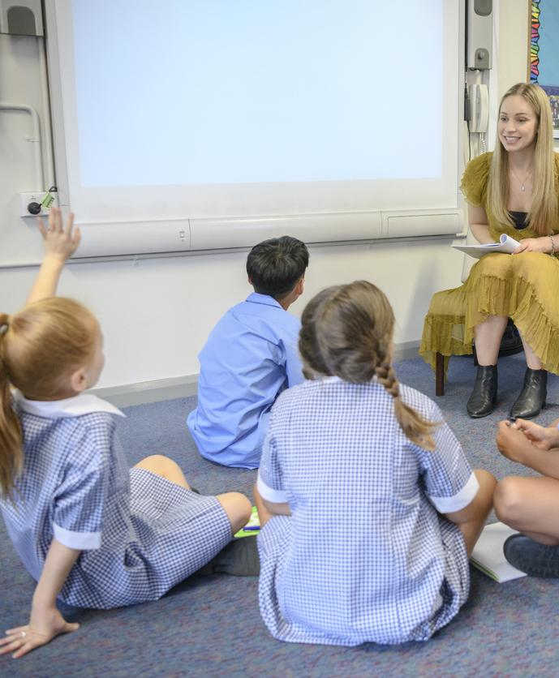
High expectations for student behaviour
Examples
Expecting students to:
move quietly in pairs when moving
through the school
be on time
line up quietly outside the classroom
listen when others are speaking
raise their hands when they have a question
put equipment where it belongs
follow staff members’ instructions.
Image credit: iStock.com/JohnnyGreig
Notes:
Preparation
You may want to edit the slide to reflect your school and the age of your students.
Facilitator notes
When we say we have high expectations, it’s important to be very clear about what they are and ensure they’re actually high by including specific information about what students do, how they do it and when they do it.
Give participants time to read the slide.
Notice that these expectations are high and include specific information about what students do, how they do it and when they do it.

Slide 20
Reflection
Consider our expectations of students as they move through the school.
Why are students expected to move in this way?
Are the expectations:
    clear? How do we know?
    high? How do we know?
    consistent? How do we know?
How are these expectations communicated to students?
Is there a gap between what actually happens and the expectation? How do we know?
Notes:
Preparation
If participants might be unsure of the school’s expectations for moving through the school, consider replacing the text ‘Consider our expectations for students as they move through the school’ with details of your school’s expectations. For example, ‘Our expectations for students moving through the school are that they move quietly in pairs’.
Facilitator notes
Let’s take a moment to reflect on something specific within our school. Consider our expectations of students as they move through the school.
Give participants time to discuss in small groups then share their conclusions back to the whole group. Allow 5 minutes for this discussion and sharing back.
Acknowledge feedback if this is something the school leaders and staff need to refine, communicate and enact.

Slide 21

Reflection
What high expectations for my students do I consistently maintain?
How do I maintain high expectations while maintaining relationships?
What high expectations could I more consistently maintain?
What support do I need to do that?
Notes:
Preparation
You may want to gather anonymous responses to this reflection – for example, on post-it notes or a Padlet wall (www.padlet.com). Anonymity can encourage frank responses. This data could be used to determine a focus for refinement across the school.
Facilitator notes
Give participants time to individually reflect on these questions. Allow 5 minutes for this reflection.

Slide 22
High expectations in routines
Entering the classroom routine
in a safe and orderly manner high expectation
Notes:
Facilitator notes
Routines are one of the ways that high expectations are demonstrated.
Give participants time to read the slide.

Slide 23
Routines are sequences of recurring tasks or actions that are taught and practised to become automatic.
Reflection
What repeatedly happens in our classrooms daily
or weekly that should be taught and practised as routines?
What difference does it make (or would it make)
to have these procedures become consistent
and automatic? What makes me say that?
Notes:
Preparation
Prior to facilitating this section, which is about routines, you may want to read some – or all – of these chapters from AERO’s Foundational Classroom Management Resources Handbook:
Chapter 3: Teaching routines-
Chapter 6: Entrance routine
Chapter 7: Exit routine
Chapter 8: Gaining all students’ attention
Chapter 12: Students gaining teacher attention
Chapter 13: Students moving through the school.
You may want to refer participants to the relevant chapter(s) if you’re unsure how to answer a question.
Facilitator notes
Give participants time to discuss these questions in small groups, then share back to the whole group. Allow 6 minutes for this discussion and sharing back.

Slide 24
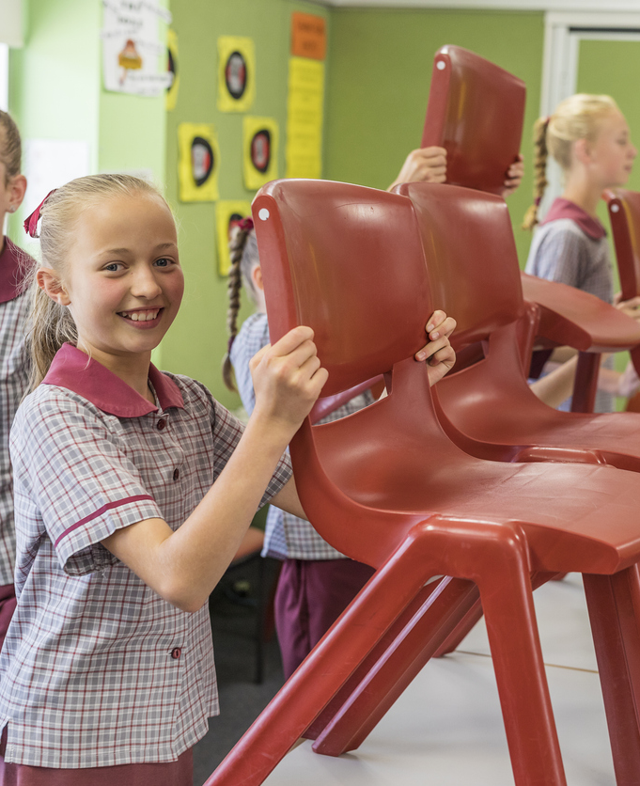
Routines
Examples
Gaining all students’ attention
Students gaining teacher attention
Entering the classroom
Moving through the school
Exiting the classroom
Daily, weekly and monthly review
Starter activity
Random selection for student response
Self-review
Image credit: iStock.com/davidf
Notes:
Facilitator notes
Take a moment to read this slide. This is not an exhaustive list of all the routines that occur in a school, but there may be some examples you didn’t think of during the discussion.
Give participants time to read.
Routines provide structure – sequences or steps - for students to know what to do, how to do it and when to do it.
A procedure only becomes a routine when it’s taught and practised to become automatic, meaning minimal effort is required in thinking about it. This frees up students' working memory so they can focus on learning.
As students learn to perform the routine independently, teachers are freed up to focus on other things, such as providing additional support to students needing it.
Efficiency in performing routines also enables more teaching and learning time.

Slide 25
Rules
Positively framed
Clearly communicated
Short instructions for conduct or action:
  avoid overloading working memory
  easy to remember
  limit distraction from learning
Consider community values and perspectives
Notes:
Preparation
This section is about rules. Prior to facilitating this section, you may want to read Chapter 4 of AERO’s Foundational Classroom Management Resources Handbook. You may want to refer participants to this chapter if you’re unsure how to answer a question.
Be prepared to share examples of community values and language reflected in the school rules.
Facilitator notes
High expectations are also clarified through rules. Rules should be positively framed in that they tell students what to do. A negatively framed rule, telling them what not to do, can feel punitive and leave a student wondering what they’re allowed to do.
They need to be clearly communicated short instructions for conduct or action that students understand and can remember.
Consider community values and perspectives to draw on their strengths in establishing rules and use language and expectations that are familiar to students.

Slide 26
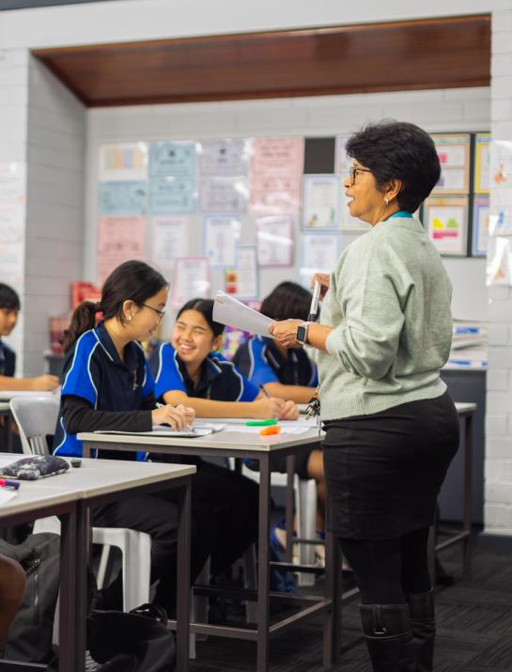
Rules
Examples
Treat everybody with kindness.
Listen and speak in a respectful way.
Walk quietly through the school.
Be prepared with required items.
Be in the right place.
Include others and accept difference.
Image credit: AERO
Notes:
Preparation
- You may want to adjust these examples for your context and the age of your students.
Facilitator notes
As you read these examples, notice the positive framing, clarity and instructions for conduct or action.
How might these be adapted to reflect our school community values and perspectives?
Give participants time to read the slide.

Slide 27
Scenario reflection
Mrs B. creates 10 classroom rules aimed at preventing unwanted behaviours such as
‘No calling out’, ‘Don’t be late’, ‘Don’t be rude’ and ‘Never leave without permission.’
During a recent lesson, she needed to remind students on 4 occasions that
‘No calling out’ is a rule.
Mrs B. found that her students argued with her when she reminded them of the rules.
What does this scenario tell us about the students’ understanding of the rules?
How might Mrs B. make her rules more effective?
Notes:
Facilitator notes
High expectations are also clarified through rules. Let’s consider this scenario.
Instruct participants to:
read the slide
take a few minutes to discuss the questions with their table or partner
be ready to share their thoughts so you can reach a collective understanding.
Allow 8 minutes for this discussion and sharing back.

Slide 28
Explicitly teaching an expectation, routine or rule
Introduce the expectation, routine or rule, including why it’s important.
Model, explain and discuss it.
Support students to practise it.
Ask students to demonstrate it independently. Provide feedback. Practise again.
Remind, monitor, acknowledge and praise.
Respond to students if they don’t demonstrate it, practising again when needed.
Notes:
Preparation
This slide demonstrates the process to explicitly teach an expectation, routine or rule.
Please select one of the facilitator notes, depending on how much detail your audience needs to understand why behaviour is explicitly taught.
If you select the detailed version, you may need to edit the final dot point to reflect the age of your students.
Please delete the facilitator notes you won’t use.
Facilitator notes (detailed version)
Give participants time to read the slide.
We teach behaviour just like we teach academic content.
When a student makes an error in learning, we support them to correct it. The same occurs for mistakes in behaviour.
Explicitly teaching expected behaviour helps to free up students’ working memory to focus on learning. This involves introducing the expectation, routine or rule and why it’s important, and modelling, explaining and discussing it.
Practising expected behaviours helps make them increasingly ‘automatic’ and become an established habit for students.
Students don’t necessarily know to transfer the expectations from outside of school to the school environment. And sometimes the expectations are different in the school environment. There are certain ways we do things at school.
Teachers should proactively and explicitly teach expected behaviour at the start of the academic year and revise regularly.
Teachers should also role-model the behaviours expected of students, including arriving to class on time, being organised, and listening to and speaking with students in a consistent and calm manner to set the standard about how to interact in the classroom.
We make the expectations/routines/rules explicit, not secret. We equip students to follow them. Many of our students need this explicit teaching to demonstrate the expected behaviour of our school.
Facilitator notes (less detailed version)
We teach behaviour just like we teach academic content. We make the expectations/routines/rules explicit, not secret. We equip students to follow them. Many of our students need this explicit teaching to demonstrate the expected behaviour of our school.

Slide 29
Proactive and preventative approaches
Positive relationships
High expectations, routines and rules
Notes:
Facilitator notes
We’ve spoken about these evidence-based approaches for classroom management.
AERO has identified 7 classroom management skills that support these approaches.

Slide 30
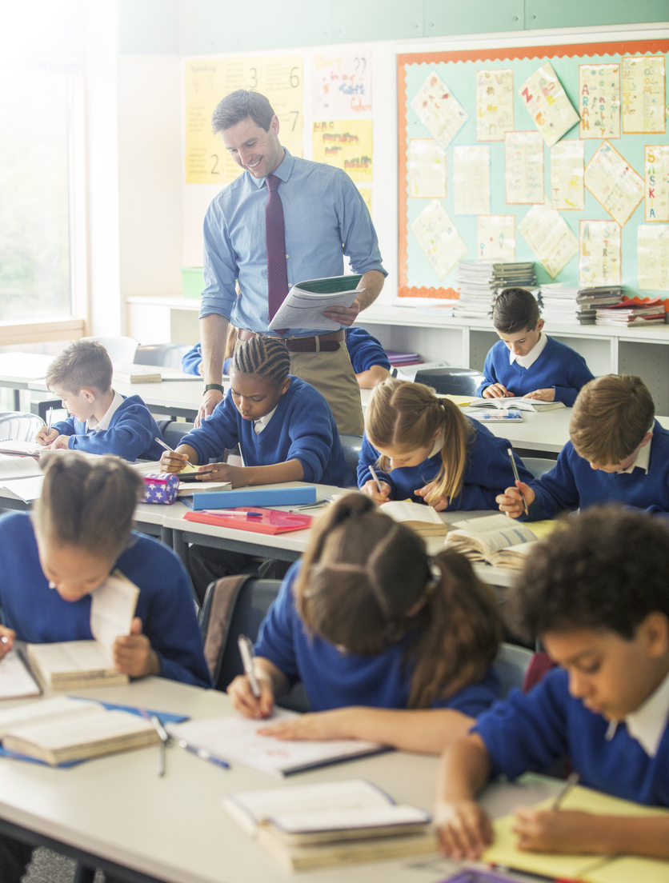
Classroom management skills
Acknowledgement and praise
Circulation
Clear communication
Deliberate pause
Non-verbal correction
Scanning your class
Voice control
Image credit: iStock.com/Caiaimage/Chris Ryan
Notes:
Preparation
Prior to facilitating this section, which is about classroom management skills, you’re encouraged to refer to these chapters from AERO’s Foundational Classroom Management Resources Handbook:
Chapter 14: Acknowledgement and Praise
Chapter 15: Circulation
Chapter 16: Clear communication
Chapter 17: Deliberate pause
Chapter 18: Non-verbal communication
Chapter 19: Scanning your class
Chapter 20: Voice control.
You may want to refer participants to the relevant chapter(s) if you’re unsure how to answer a question.
Each of these chapters has:
advice for rehearsing the skill
elements for success for the skill.
Use these to rehearse each skill so that you can clearly incorporate the elements for success as you model the skill.
Facilitator notes
Give participants time to read.
Let’s walk through an example. We’ll think about the combination of skills we need to gain all students’ attention. Imagine our students are focusing their attention on something other than us, and we have something to say, so we need to gain attention from every student.

Slide 31
Classroom management skills
Acknowledgement and praise
Circulation
Clear communication
Deliberate pause
Non-verbal correction
Scanning your class
Voice control
Notes:
Preparation
On this and the following slides, the skills in bold are those being modelled in this demonstration.
Facilitator notes
Firstly, we’ll need to use a cue to let them know that we would like their attention. If the cue is verbal, then we’ll need to use voice control.
Demonstrate using a verbal cue such as a countdown or call and response (‘Marco-Polo, 1, 2, 3 eyes on me -1, 2 eyes on you’).

Slide 32
Classroom management skills
Acknowledgement and praise
Circulation
Clear communication
Deliberate pause
Non-verbal correction
Scanning your class
Voice control
Notes:
Facilitator notes
Next, we deliberately pause. This gives students time to direct their attention to us.
And gives us time to monitor all students by scanning and circulating.
We acknowledge and praise students who have given us their attention
Demonstrate the full sequence so far, from the verbal cue.

Slide 33
Classroom management skills
Acknowledgement and praise
Circulation
Clear communication
Deliberate pause
Non-verbal correction
Scanning your class
Voice control
Notes:
Facilitator notes
After acknowledging and praising the students who have given us their attention, we use a non-verbal correction for students who have not given their attention.
Demonstrate giving a non-verbal correction – e.g., moving to a student (proximity) and pausing to prompt a student to focus.

Slide 34
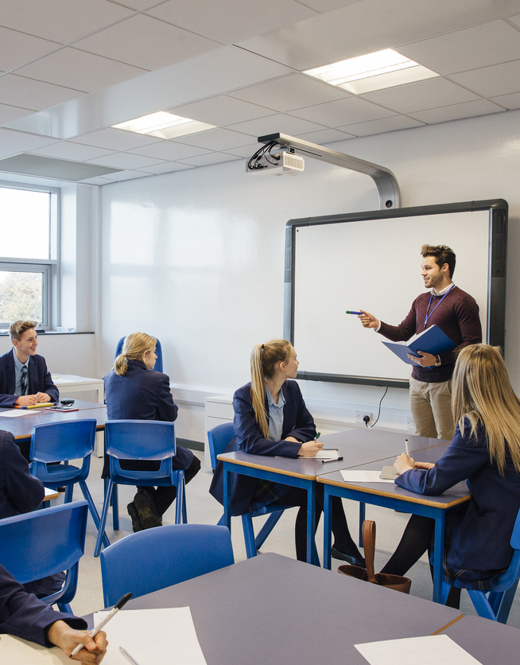
Classroom management skills
Acknowledgement and praise
Circulation
Clear communication
Deliberate pause
Non-verbal correction
Scanning your class
Voice control
Image credit: iStock.com/DGLimages
Notes:
Facilitator notes
We acknowledge and praise students when they correct their behaviour.

Slide 35
Classroom management skills
Acknowledgement and praise
Circulation
Clear communication
Deliberate pause
Non-verbal correction
Scanning your class
Voice control
Notes:
Facilitator notes
We need to use voice control and clear communication to give the instruction that we gained the students’ attention for in the first place.

Slide 36
Proactive and preventative approaches
Positive relationships
High expectations, routines and rules
Notes:
Facilitator notes
By using evidence-based, proactive and preventative approaches to classroom management – establishing and maintaining positive teacher–student relationships and explicitly teaching and reinforcing high expectations, routines and rules – we’re most efficiently and effectively able to create safe and supportive learning environments for all students.

Slide 37

Planning for classroom management
      Reflect on your classroom management practices and skills
      Plan for the first day and the
      first few weeks
      Continue to reflect on the impact of your practices and skills to plan
      for classroom management throughout the year
Notes:
Facilitator notes
Remind participants of the definition of classroom management – Classroom management is about ‘The actions teachers take to create an environment that supports and facilitates both academic and social-emotional learning’.
These actions are intentional and planned.
So much preparation is done before students join us. Chapter 9 in the Foundational Classroom Management Resources Handbook provides guidance on what to do during this very important time.

Slide 38


Questions
Notes:
Preparation
This slide is optional. You might prefer to suggest another way for staff to reach out to you – for example:
putting questions on sticky notes for you to consider and respond to
a conversation with you after the session
emailing ideas or reflections to you after the session
setting optional 'drop-in' sessions during the following week for follow up questions and discussions.
Facilitator notes
Invite questions. Feel comfortable taking some time to consider the question and do some research before responding later.

Slide 39
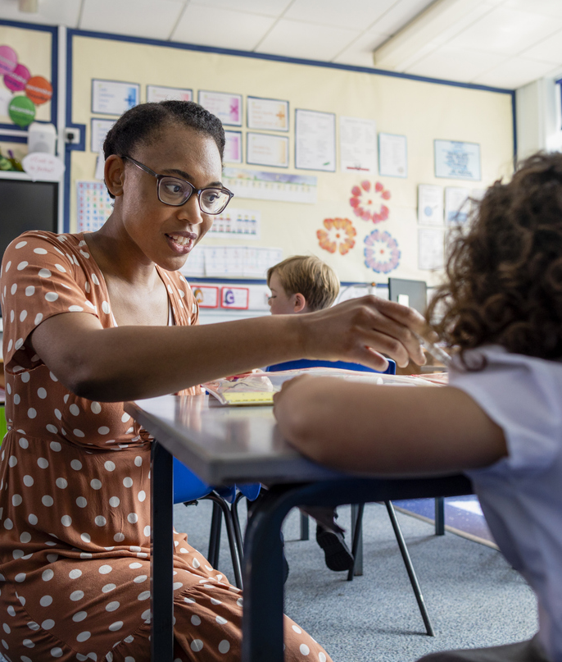
Responding to disengaged and disruptive behaviour
Image credit: iStock.com/Solstock
Notes:
Preparation
Prior to facilitating this section, you may want to read Chapter 10 of AERO’s Foundational Classroom Management Resources Handbook. You may want to refer participants to this chapter if you’re unsure how to answer a question.
Facilitator notes
We’ll now focus on responding to disengaged and disruptive behaviour and how to respond to ensure students can re-engage while we maintain the relationship with them.
While proactive classroom management is a preventative strategy, at times, students will demonstrate disengaged and disruptive behaviours.
Disengaged behaviour includes passive disengagement, which might look like sitting quietly but not listening to the teacher, half-completion of tasks and requiring reminders to get work done.
Disruptive behaviour refers to low-level actions that impact negatively on teaching and other students’ learning, such as calling out, interrupting others, being restless, getting out of their seat and not following the teacher’s instructions.
It’s these 2 categories of student behaviours not meeting expectations that most impact teaching and learning.
We’ll now look at how we respond to students displaying these behaviours to support our students to re-engage in their learning.

Slide 40
Responding to disengaged and disruptive behaviour
Maintain
      safe and supportive learning environment
      relationships
      high expectations, routines and rules
      focus on learning
Remind of the behaviour expectations
Teach the necessary skills
Notes:
Facilitator notes
The aim of any intervention is to maintain:
a safe and supportive learning environment
relationships
high expectations, routines and rules
a focus on learning.
We do this by reminding students of expectations, routines and rules and teaching students in a safe and supportive way.

Slide 41
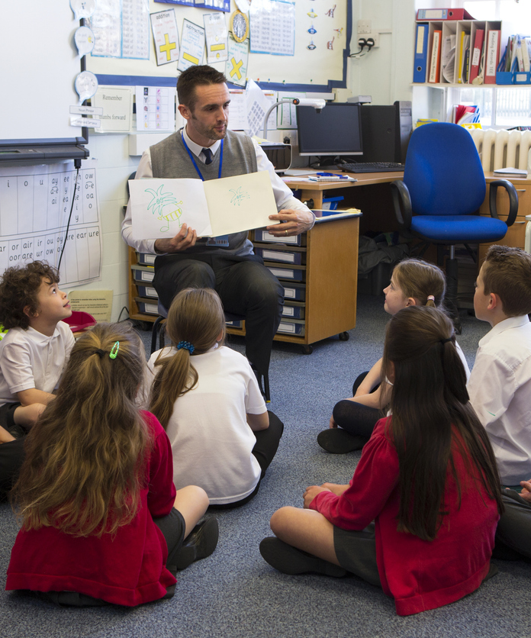
Responding to disengaged and disruptive behaviour
      Know your students
      Plan to prevent
      Prepare to respond
      Support student safety and focus on learning
      Be respectful and polite
      Speak calmly
Image credit: iStock.com/DGLImages
Notes:
Facilitator notes
It’s important to know our students and how they react in different contexts. We plan in advance to prevent and prepare to effectively respond to disengaged and disruptive behaviour.
We know that disengagement and disruption will occur at times, so it’s useful to prepare and rehearse responses before we encounter it.
The aim of any response is to support student safety and focus on learning, while maintaining high expectations.
While student behaviour may be directed at you or feel personal, the most effective intervention is calm and respectful. Use a calm tone, respect and politeness.

Slide 42
Responding to disengaged and disruptive behaviour
Single response
Combination of responses
Escalation of responses
Notes:
Facilitator notes
Students will often respond to a single non-verbal or verbal correction, but sometimes, it will take a combination or escalation of responses to correct behaviour and support students to re-engage in learning.

Slide 43
Responding to disengaged and disruptive behaviour
Monitor all students.
Use a non-verbal correction.
Use a verbal correction.
Give a choice.
Implement the consequence.
Notes:
Preparation
Rehearse the demonstration outlined in the facilitator notes for this slide. Chapter 10 of AERO's Foundational Classroom Management Resources Handbook includes a section titled ‘Rehearse and practise responding to disengaged and disruptive behaviour’. Use the checklists in this section to prepare the demonstration described in the facilitator notes.
Prepare to explain what happens at your school after step 5 on the slide, if a student has still not corrected their behaviour.
Facilitator notes
Demonstrate steps 1-5, addressing an imaginary student. As you demonstrate, explicitly point out that you’re:
using a calm tone, respect and politeness
minimising disruption to learning
supporting student safety and focus on learning, maintaining high expectations.
I planned and rehearsed this demonstration, which is exactly what we all need to do. We use our knowledge of our students to plan and rehearse how we’ll consistently respond to behaviour in our school.

Slide 44
Classroom management
Approaches
Practices
Skills
Positive Teacher–Student Relationships
High Expectations for Student Behaviour
Teaching Routines
Establishing and Maintaining Rules
Planning for Classroom Management
Building Connections With All Students
Gaining All Students’ Attention
Students Gaining Teacher Attention
Entrance Routine
Setting Behaviour Expectations for Completing Learning Tasks
Exit Routine
Students Moving Through the School
Responding to Disengaged and Disruptive Behaviour
Acknowledgement
and Praise
Circulation
Clear Communication
Deliberate Pause
Non-Verbal Correction
Scanning Your Class
Voice Control
Notes:
Preparation
On this slide, participants will select an approach, practice or skill to focus on. Consider:
asking participants to share their selected focus with a team or school leader
allocating additional time at this point of the session for participants to read, and start to work through, the relevant chapter of the handbook.
Facilitator notes
Today, we’ve looked at proactive and preventative approaches for our whole-school approach to classroom management.
We also looked at practices and skills that support these approaches.
Take a moment to reflect on this session and select one approach, one practice or one skill that you’ll focus on in the coming weeks. Once you’ve selected a focus, discuss it with a colleague explaining why you’ve chosen this focus.
Give participants time to discuss and identify if any participants have selected the same focus areas. They may want to work together on the activity on the next slide and then touch base with each other in the following weeks to reflect.

Slide 45
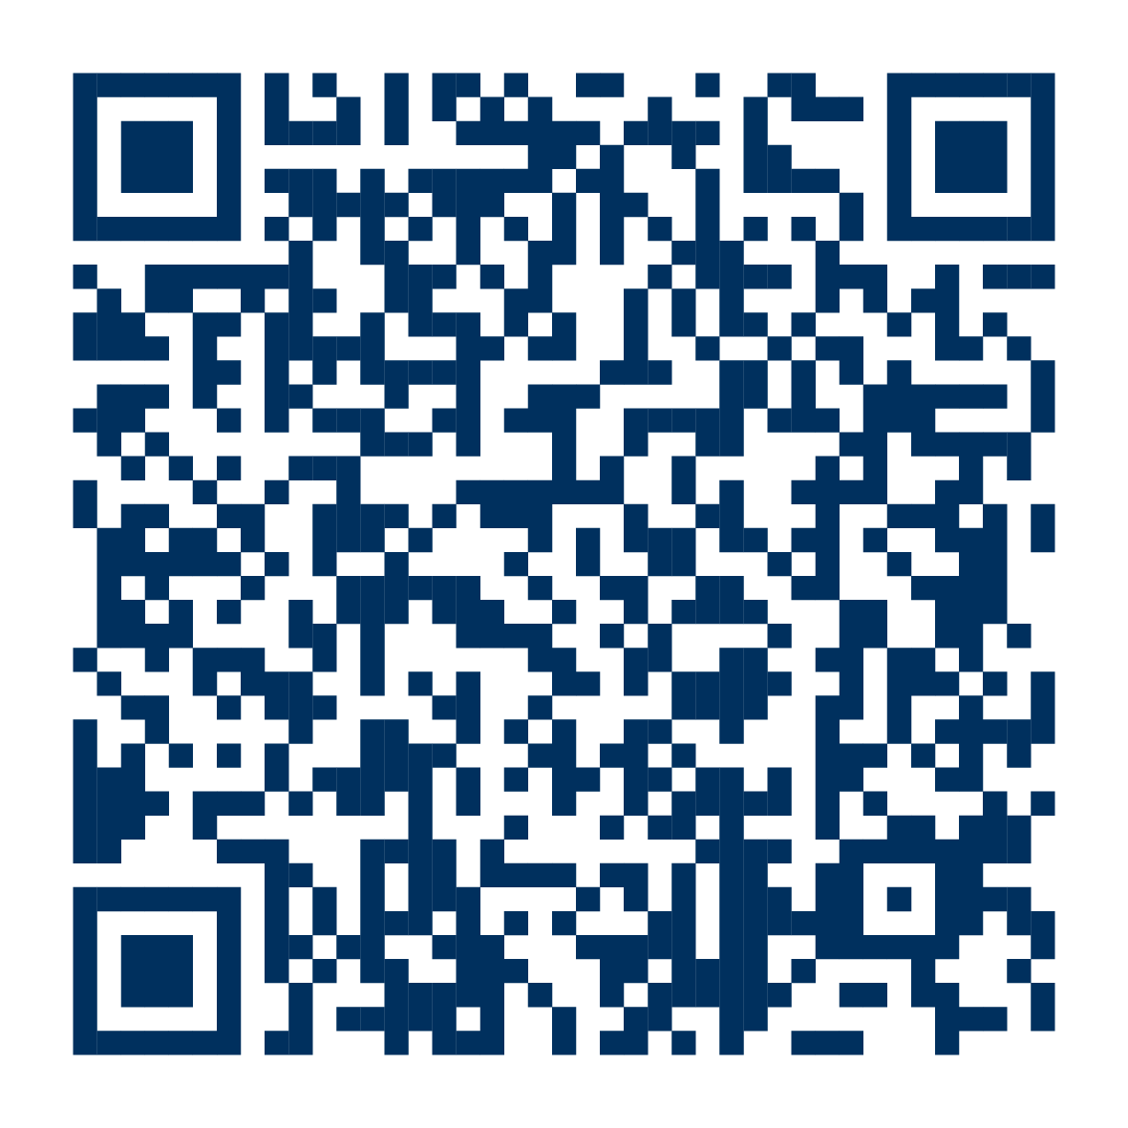
edresearch.edu.au/classroom-management-handbook
Notes:
Facilitator notes
Prompt participants to download AERO’s Foundational Classroom Management Resources Handbook, if they haven’t already done so.
AERO has released a classroom management resource for each approach, practice and skill listed on the previous slide. So, whatever focus you’ve selected, there’s a resource to support you. The resources are compiled in the handbook.
Give participants time to find and read the chapter of the handbook for the focus they’ve chosen.

Slide 46
Feedback
Notes:
Preparation
You may want to prepare a feedback form for staff to complete at the end of the session. If so, add instructions for accessing it to this slide.
Remember to delete the preparation sections in the slide notes throughout the slide deck once you’ve followed their instructions.

Slide 47
References
Blazar, D., & Pollard, C. (2022). Challenges and tradeoffs of “good” teaching: The pursuit of multiple educational outcomes (EdWorkingPaper 22–591). Annenberg Institute at Brown University. https://doi.org/10.26300/ajht-4d94
Evertson, C. M., & Weinstein, C. S. (Eds.). (2006). Handbook of classroom management: Research, practice, and contemporary issues. Lawrence Erlbaum Associates Publishers.
Peddie, B., Kelly, M., Greengard, T., Whiting, C., & Richardson, S. (2024). Foundational classroom management resources handbook. Australian Education Research Organisation. https://www.edresearch.edu.au/guides-resources/practice-resources/foundational-classroom-management-resources-handbook
Richardson, S., Kelly, M., Whiting, C. & Peddie, B. (2023). Effectively managing classrooms to create safe and supportive learning environments. Australian Education Research Organisation. https://www.edresearch.edu.au/research/research-reports/effectively-managing-classrooms-create-safe-and-supportive-learning-environments

Slide 48

Notes:
More copyright information: https://creativecommons.org/licenses/by/4.0/deed.en

